Slide 1
Technology Review
Purple Haze
Tyler Cox, Carley Fredrickson, Greta Shum, and Adam Sokol
CSE 583
November 12, 2020

Slide 2
Problem to Solve
As personal air quality instruments are becoming popular with PurpleAir, Purple Haze aims to answer the following questions:
Is the distribution of PurpleAir sensors in Seattle equitable?
Are people of disadvantaged socioeconomic status disproportionately affected by poor air quality?
We have socioeconomic data in a shapefile format and PurpleAir (air quality) data with latitude/longitude labels
We need a way to connect these two different ways of giving location information

Slide 3
What are shapefiles?
Shapefiles store nontopological geometry and attribute information for spatial features in a data set
Supports point, line, and area features
The shapefile format requires at least these 3 components:
a main file that contains the feature geometry (.shp)
an index file that stores the index of the feature geometry (.shx)
a dBASE table (.dbf) that stores the attribute information of features
Can provide definitions of the coordinate system

Slide 4
Use Case
Need to find out which census tract (shapefile) each PurpleAir sensor is in
PurpleAir sensor (data points)
1
3
Census tract (shapefiles)
2
4
5

Slide 5

Packages in Consideration
GeoPandas
Can read shapefiles using Fiona
Can create and match shapefiles
Built on Pandas infrastructure allowing for easy data plotting and grouping
Python Shapefile Library (PyShp)
Reads a shapefile header in the Reader class using the main shapefile name
Uses shape() method to read feature geometries and record() method to read feature records both in lists
Reader class has fields attribute in a list
Rasterio
Reads and writes raster datasets to/from numpy arrays
Can read in shapefiles, interpret geometry, and mask out areas out of interest
Useful for satellite data
Uses Fiona, just like Geopandas
Fiona reads and writes OGR as ‘partner’

Slide 6
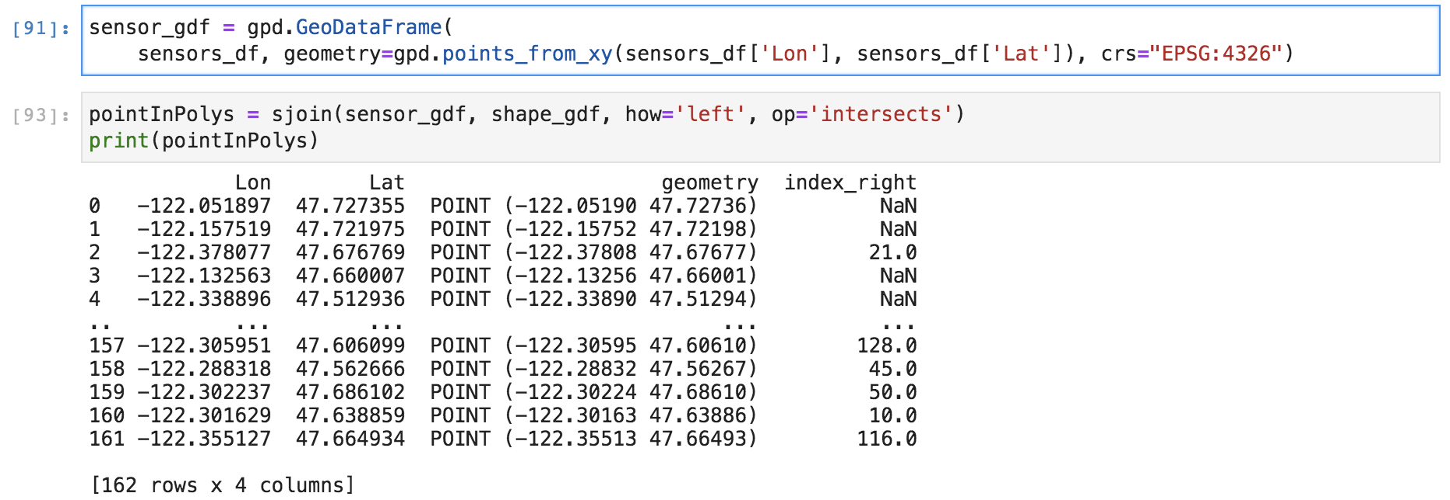
Geopandas
Pros:
Easy to use given group members experience with pandas
Has functionality to read in shapefiles, and then perform the matching explained in our test case
The ‘matching’ functionality is quick (~0.5 seconds for our 162 Purple Air stations) and easy to perform
Extensive documentation of functions
Can convert between coordinate systems
Cons:
Forces you to use Pandas dataframe functionality
Possibly less customizable compared to some other more basic alternatives

Slide 7

Rasterio
Read more: GitHub, Docs, Groups
Pros:
If we had a million PurpleAir stations, it would be computationally better to rasterize shapefiles and mask out points
If we were using data from Satellite images of the smoke in Seattle, Rasterio would allow us to interpret that data (not our project)
Allows flexibility for larger spatial analysis
Cons:
Extra steps to rasterize shapefile to perform analysis
already have Census data in shapefiles

Slide 8
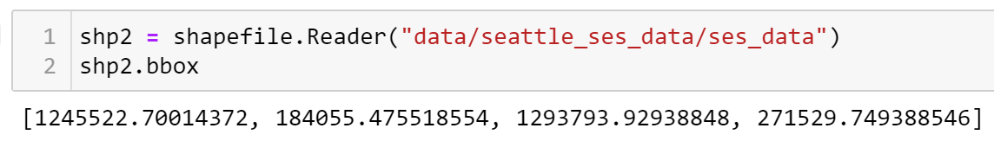
PyShp
Drawbacks:
No built-in methods to transform the coordinate system!
You cannot use it for geometric operations, it is purely a reader and writer of shapefiles
Import name is not pyshp, so hard to remember this is the package
Appeal:
Simplicity in operation and function
PyShp is compatible with Python 2.7-3.x.
Active Python package, with issues being closed as recently as September 2020
Ability to load shapefiles from a url, a zip file, a serialized object, or a database
For large Shapefiles, PyShp has an iterator option
Not lat/lon degrees, feet!
Coordinate system centered west of Ellensburg, WA

Slide 9
Final Decision
Geopandas
Ease of transforming coordinate system
Operates with well-known pandas DataFrames
Well-documented and maintained

